Slide 1
Final Project - Real Esate

Slide 2
Database
Source: https://www.kaggle.com/austinreese/usa-housing-listings.
Picked this dataset to analyse how location,building type, square footage, number of bedrooms and being pet friendly can affect the rental price in the housing market in the US.
This dataset has 22 columns (9 integer, 6 string, 3 url, 4 boolean).
To Load the data into the database:
Created a Postgres server in AWS - RDS.
Loaded the “Housing” table in the postgres database using PgAdmin.
A connection link is created in the jupyter notebook with all the credentials.

Slide 3
Database Setup
RDS setup in AWS.
Database setup.
Created a database
Created a table named “Housing”
Loaded the data

Slide 4
Database usage
Created a config file with all the the credentials.
Imported libraries like sqlalchemy and psycopg2.
Imported the variables from the config file.
Connected to the database using the libraries and the credentials.
Executed a sql query to import all the table data. Used read_sql_query from the pandas library to import the table data.

Slide 5
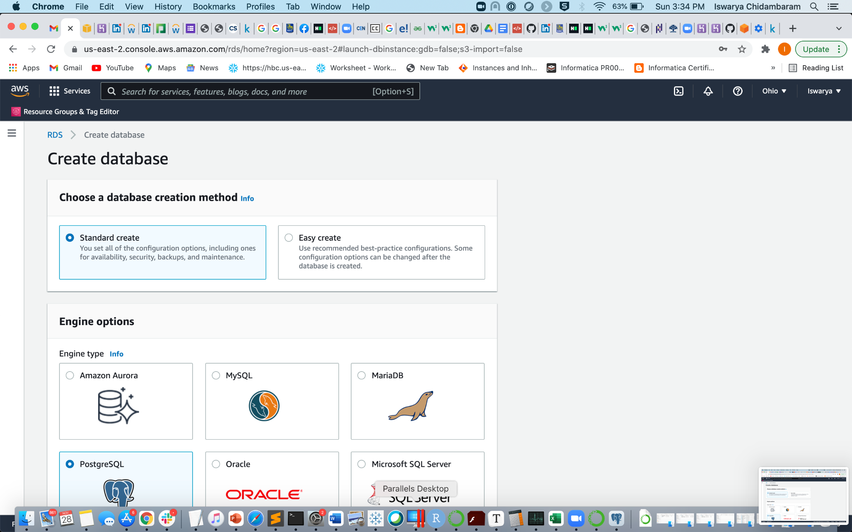
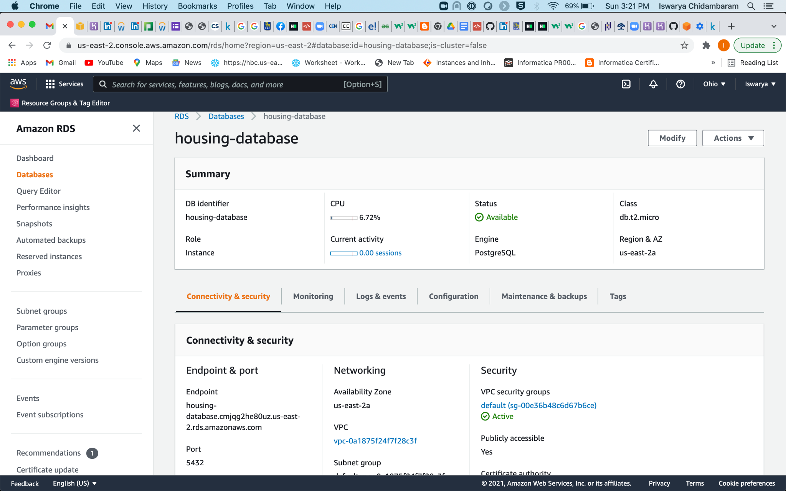
Screenshots of RDS server :
RDS server:

Slide 6
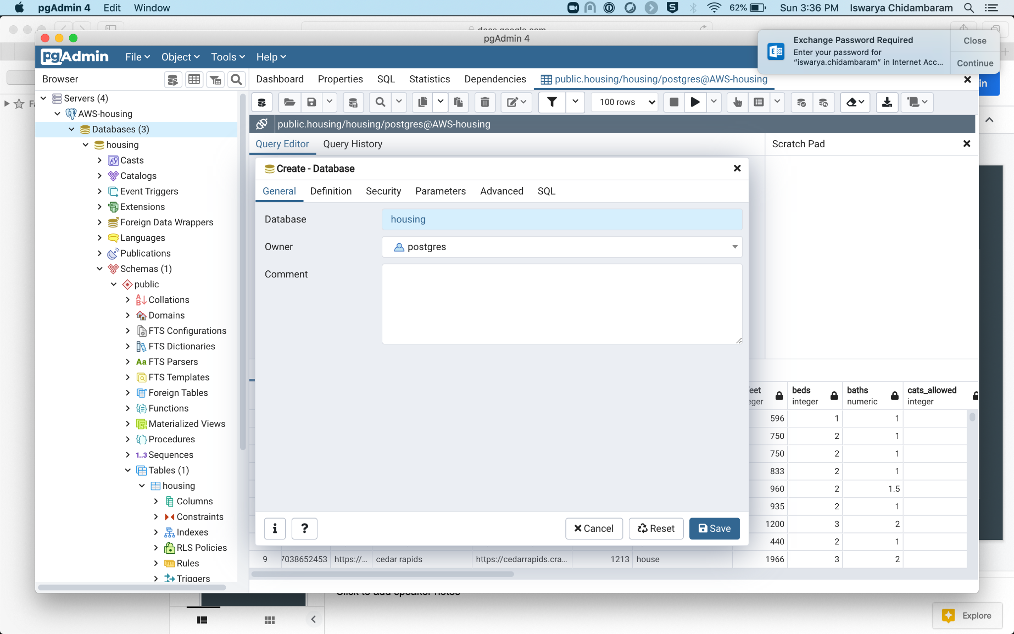
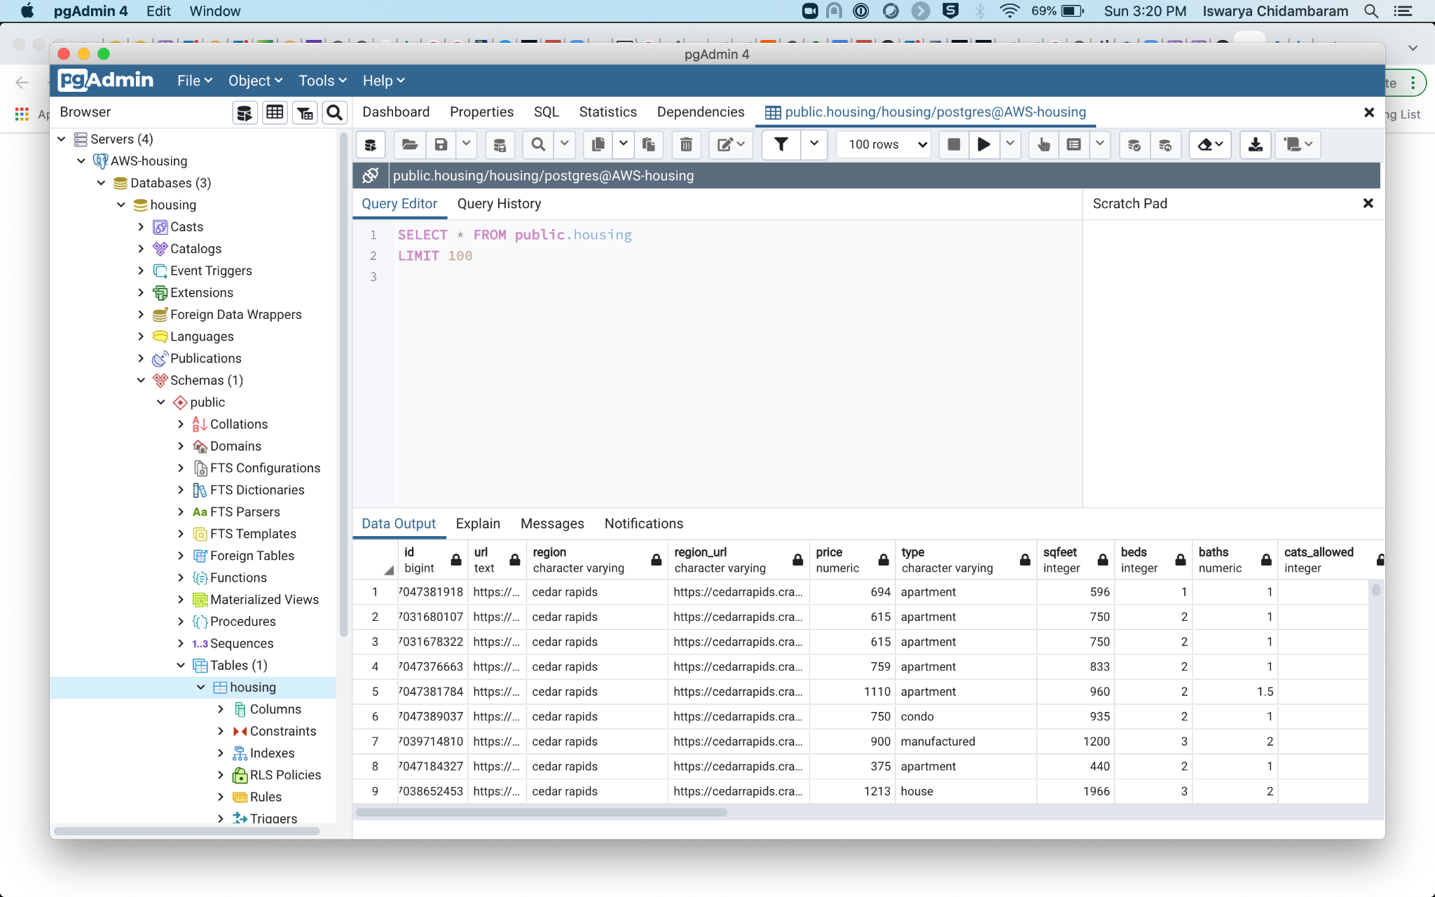
Screenshot of PgAdmin:

Slide 7
Data Cleaning

Slide 8
Machine Learning

Slide 9
Data Visualization

